Slide 1
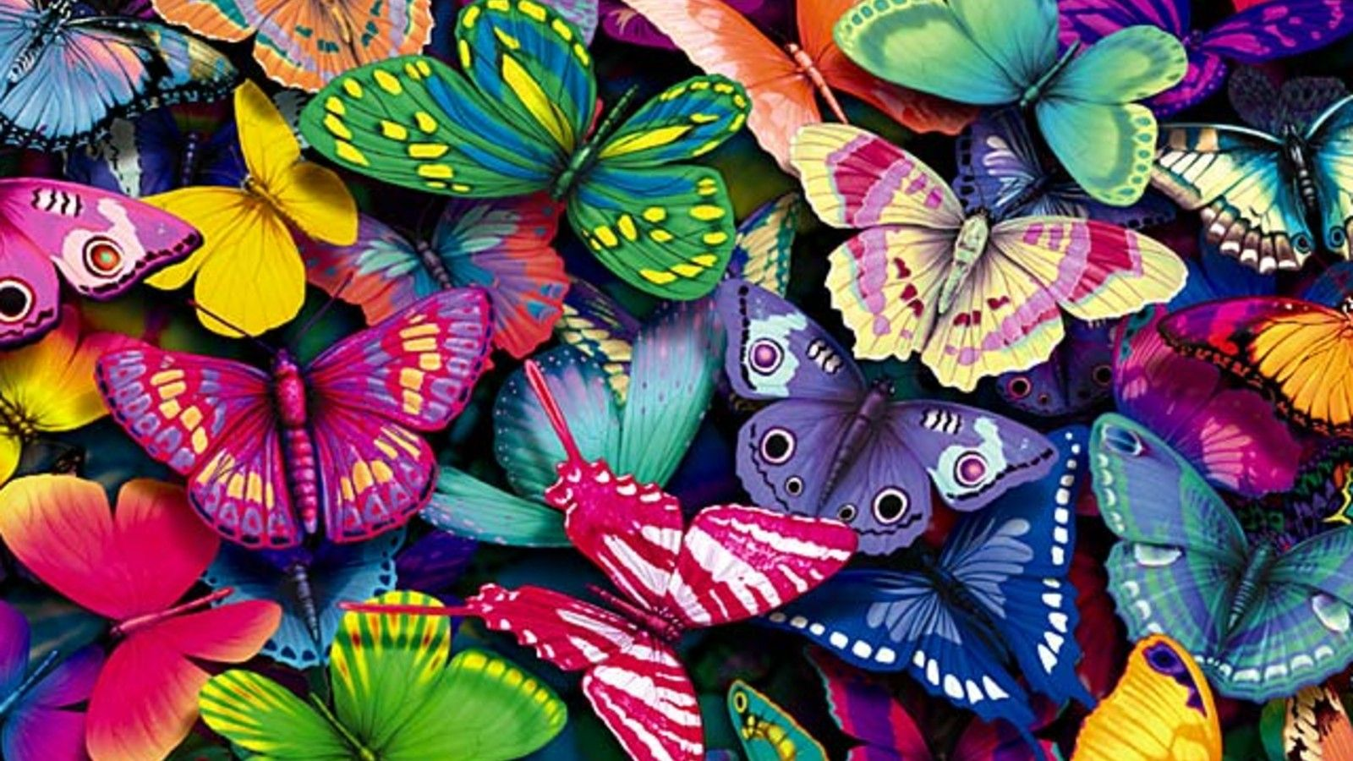
The Life Cycle of a Butterfly
Presented by Abigail Guthrie

Slide 2
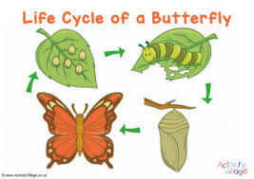

Slide 3
What are the Stages of the Life Cycle of a Butterfly?
Use Google to help you find the answer to the above question.
Type your answers on the white blank screen.

Slide 4
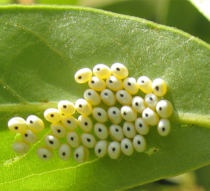
1st Stage: Egg

Slide 5
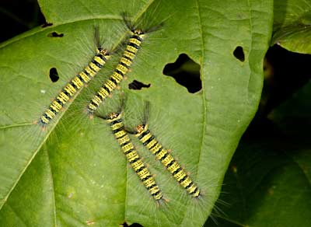
2nd Stage: Larva / Caterpillar

Slide 6
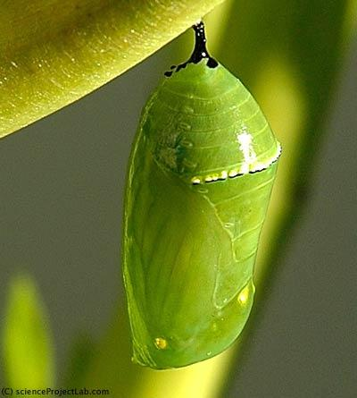
3rd Stage: Pupa / Chrysalis

Slide 7
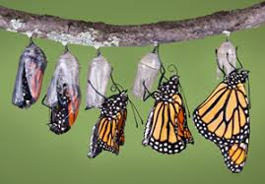
4th Stage: Adult Butterfly

Slide 8
Research
Research some interesting facts about the life cycle of butterflies. You will have 5 minutes to research.
Find one interesting fact that you would like to share with the class.

Slide 9
https://www.turacogames.com/games/butterfly-life-cycle-science-game-for-kids/

Slide 10
Questions / Comments?

